Slide 1
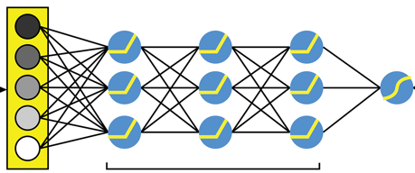

Class
Negative
Neutral
Positive
Class
Negative
Partially Negative
Neutral
Partially Positive
Positive
Pre-Processing
Sentiment
Websites: YELP, IMDB
Dense Embeddings
DNN -Hidden Layer
word2Vec, KMeans, Gensim,
Rule-based NLP, TextBlob vs VADER
BERT- AutoModel : HuggingFace
Auto-tokeniser & Ktrain
Bert – Pretrained Model

